Slide 1
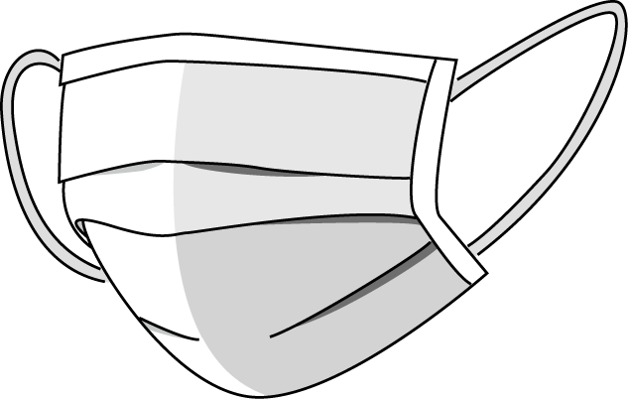

Face Mask
Detection

Slide 2
Dataset
Libraries
import os, shutil
import pandas as pd
import numpy as np
import cv2
import matplotlib.pyplot as plt
from keras import layers
from keras import models
import cvlib as cv
from keras import optimizer
from keras.preprocessing.image import ImageDataGenerator

Slide 3
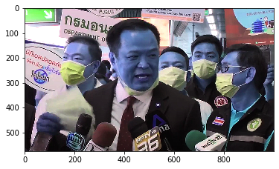
Face Detection
image_path = r'Medical Mask/Medical Mask/Medical Mask/images/6433.png'
im = cv2.imread(image_path)
plt.imshow(im)
plt.show()

Slide 4
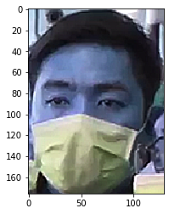
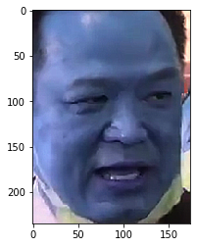
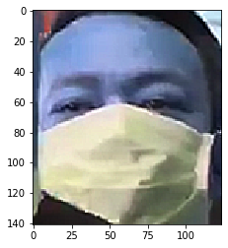
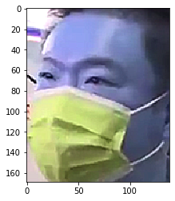
Training Images from Cropped Photo

Slide 5
Data Preparation
 | name | x1 | x2 | y1 | y2 | classname
13381 | 1801.jpg | 451 | 186 | 895 | 697 | face_no_mask
3463 | 1802.jpg | 110 | 71 | 273 | 272 | face_with_mask
14835 | 1803.jpg | 126 | 75 | 303 | 333 | face_with_mask
5867 | 1804.jpg | 112 | 113 | 262 | 307 | face_with_mask
6194 | 1805.jpg | 728 | 180 | 853 | 336 | face_with_mask

Slide 6
Training The Model
1 | from keras import layers
2 | from keras import models
3 | model = models.Sequential()
4
5
6 | model.add(layers.Conv2D(32, (3, 3), activation='relu',
7 | input_shape=(50, 50, 3)))
8 | model.add(layers.MaxPooling2D((2, 2)))
9 | model.add(layers.Conv2D(64, (3, 3), activation='relu'))
10 | model.add(layers.MaxPooling2D((2, 2)))
11 | model.add(layers.Conv2D(128, (3, 3), activation='relu'))
12 | model.add(layers.MaxPooling2D((2, 2)))
13 | model.add(layers.Conv2D(128, (3, 3), activation='relu'))
14 | model.add(layers.MaxPooling2D((2, 2)))
15 | model.add(layers.Flatten())
16 | model.add(layers.Dense(512, activation='relu'))
17 | model.add(layers.Dense(1, activation='sigmoid'))

Slide 7
Model Summary
conv2d_1 (Conv2D)
max_pooling2d_1 (MaxPooling2
conv2d_2 (Conv2D)
max_pooling2d_2 (MaxPooling2
conv2d_3 (Conv2D)
max_pooling2d_3 (MaxPooling2
conv2d_4 (Conv2D)
max_pooling2d_4 (MaxPooling2
flatten_1 (Flatten)
dense_1 (Dense)
dense_2 (Dense)
=====================================================
Total params: 307,393
Trainable params: 307,393
Non-trainable params: 0

Slide 8
Binary Crossentropy
1 | from keras.preprocessing.image import ImageDataGenerator
2
3 | train_datagen = ImageDataGenerator(rescale=1./255)
4 | test_datagen = ImageDataGenerator(rescale=1./255)
5
6 | train_generator = train_datagen.flow_from_directory(
7 | train_dir,
8 | target_size=(50, 50),
9 | batch_size=40,
10 | class_mode='binary')
11
12 | validation_generator = test_datagen.flow_from_directory(
13 | val_dir,
14 | target_size=(50, 50),
15 | batch_size=40,
16 | class_mode='binary')
Found 4311 images belonging to 2 classes. Found 1438 images belonging to 2 classes.

Slide 9
Model Fit
history = model.fit_generator(
train_generator,
steps_per_epoch=np.ceil(len(train_generator.filenames)/40),
epochs=20,
validation_data=validation_generator,
validation_steps=np.ceil(len(validation_generator.filenames)/40))

Slide 10
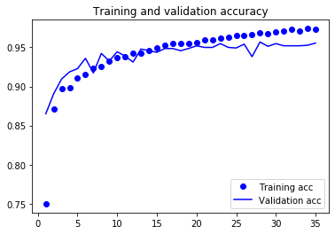
Training and Validation Accuracy
97.4%

Slide 11
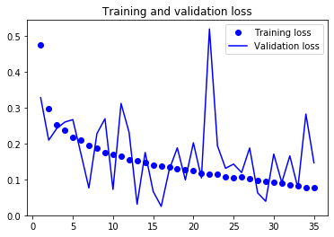
Training and Validation Loss

Slide 12
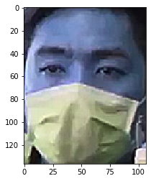
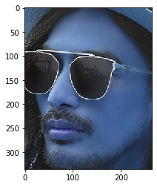
Face Confidence to Detect Mask
0.9999974966049194
0.9999982118606567
1.0
0.06689178198575974
0.14504097402095795

Slide 13
Face Confidence to Detect Mask
0.9999974966049194
0.9999982118606567
1.0
0.06689178198575974
0.14504097402095795

Slide 14

Prediction
import numpy as np
predict = model.predict_generator(validation_generator,steps = np.ceil(nb_samples/30))
predict.shape

Slide 15
Predictions
Based upon 390 images at the beginning and end:
No Mask Mean = 15.3%
Mask Mean = 94.3%

Slide 16
Mask
1
[array([0.99995935], dtype=float32), array([0.9995165], dtype=float32), array([0.96771383], dtype=float32), array([0.9993468], dtype=float32), array([0.9911833], dtype=float32), array([0.9712621], dtype=float32), array([0.9999999], dtype=float32), array([0.9831783], dtype=float32), array([0.99996734], dtype=float32), array([0.99980575], dtype=float32), array([0.30168384], dtype=float32), array([0.99913126], dtype=float32), array([0.9963814], dtype=float32), array([0.99942774], dtype=float32), array([0.99992025], dtype=float32), array([0.9999993], dtype=float32), array([0.9535538], dtype=float32), array([0.93285143], dtype=float32), array([0.9954873], dtype=float32), array([0.99999774], dtype=float32)]

Slide 17
No Mask
[array([0.0125772], dtype=float32), array([0.02725982], dtype=float32), array([0.0055486], dtype=float32), array([0.41700464], dtype=float32), array([0.09032538], dtype=float32), array([0.02786054], dtype=float32), array([0.25690556], dtype=float32), array([0.07779369], dtype=float32), array([0.0858698], dtype=float32), array([0.18215808], dtype=float32), array([0.21304154], dtype=float32), array([0.02629574], dtype=float32), array([0.04994669], dtype=float32), array([0.02906603], dtype=float32), array([0.02084493], dtype=float32), array([0.33473018], dtype=float32), array([0.30757838], dtype=float32), array([0.4773744], dtype=float32), array([0.02287194], dtype=float32), array([0.24384329], dtype=float32)]

Slide 18
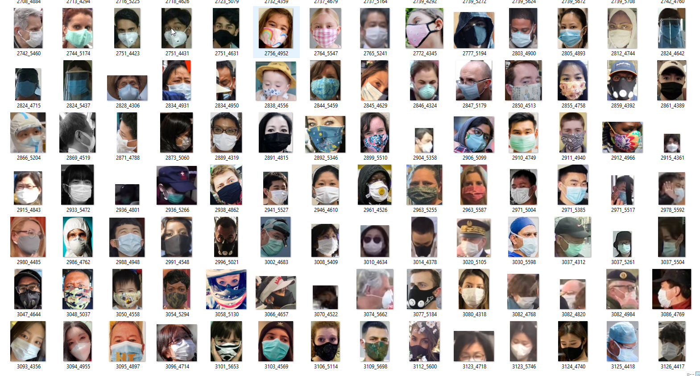

Slide 19
